Slide 1
M8

Slide 2
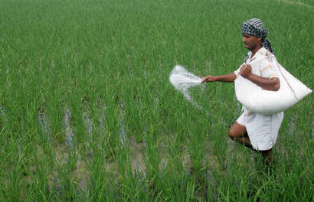
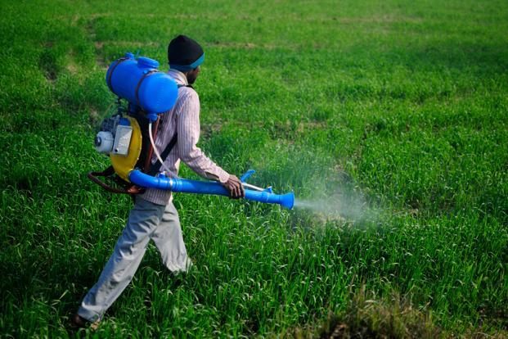
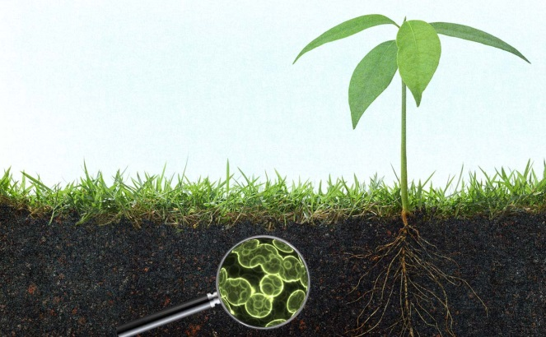
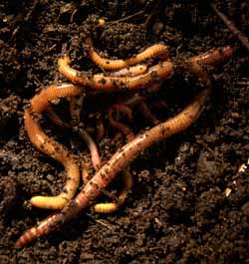


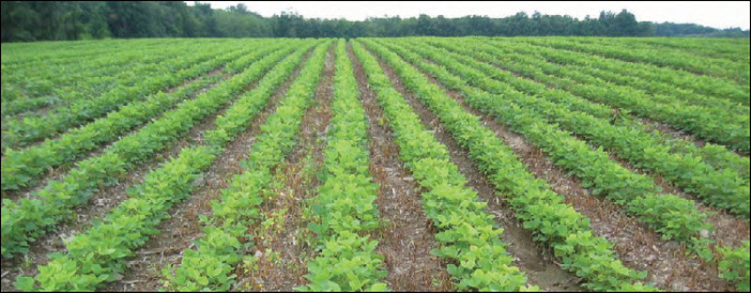
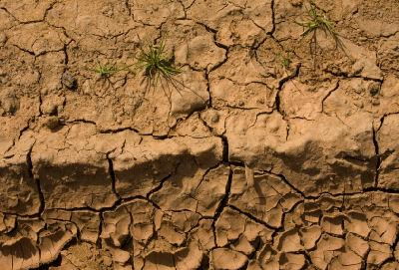
Soil pollution
Modern farming practices involve the use large amounts of fertilizers and pesticides.
Use of these substances over long periods of time can destroy the soil structure by killing the soil micro-organisms that recycle nutrients in the soil.
It also kills the Earthworms which are instrumental in making the rich humus.
Fertile soil can quickly be turned barren if sustainable practices are not followed.

Slide 3


So, how do we define soil pollution?
Removal of useful components from the soil and addition of other substances, which adversely affect the fertility of the soil and kill the diversity of organisms that live in it, is called soil pollution.

Slide 4
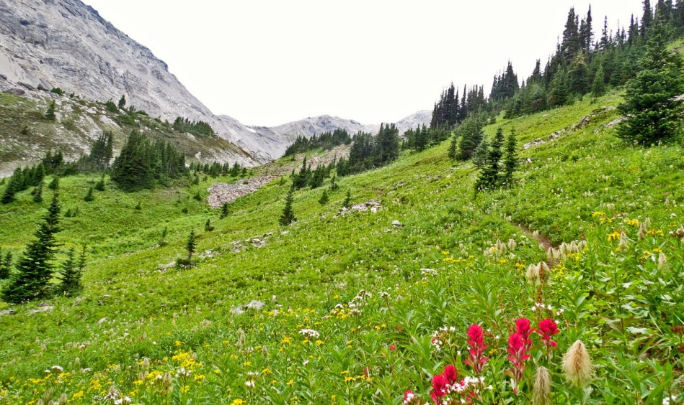
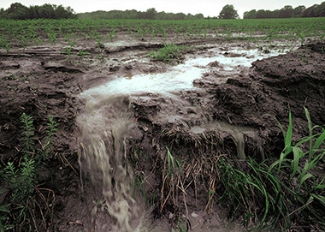
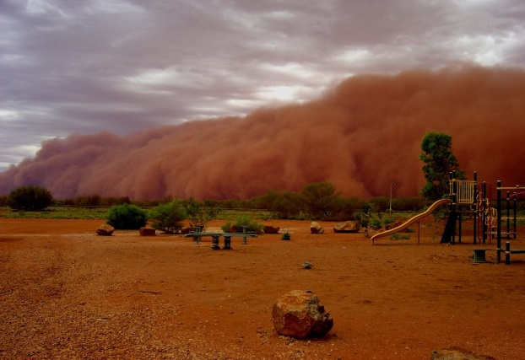
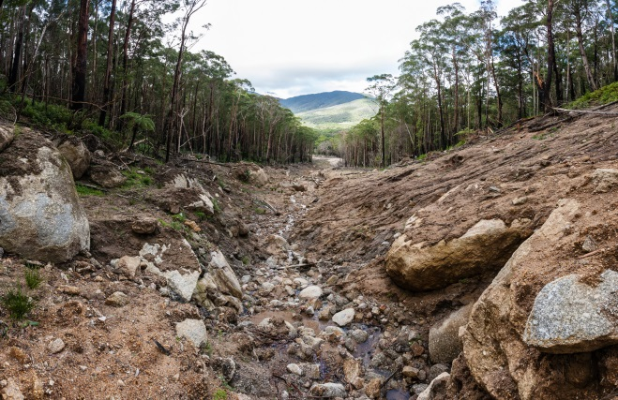
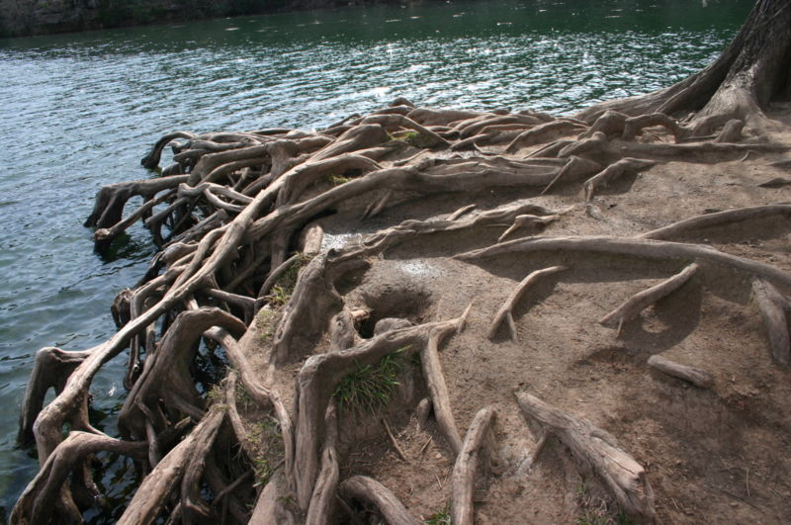
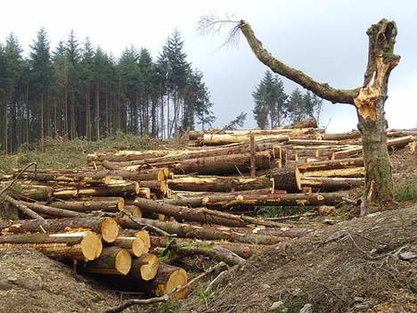
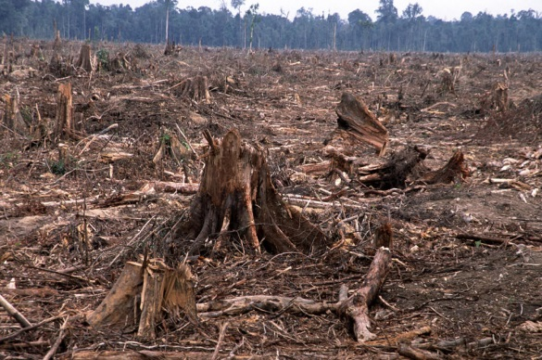
Soil erosion
The fine particles of soil may be carried away by flowing water or wind.
If all the soil gets washed away and the rocks underneath are exposed, we have lost a valuable resources are exposed, we have lost a valuable resources because very little will grow on the rock.
The roots of plants have an important role in preventing soil erosion.
The large-scale deforestation that is happening all over the
world not only destroys biodiversity, it also leads to soil erosion.
Topsoil that is bare of vegetation, is likely to be removed very quickly.
Vegetative cover on the ground has a role to play in the percolation of water into the deeper layers too.

